Slide 1
ODE Python Exam (09/23)

Slide 2
Three problems

Slide 3
Plot (60 points)

Slide 4
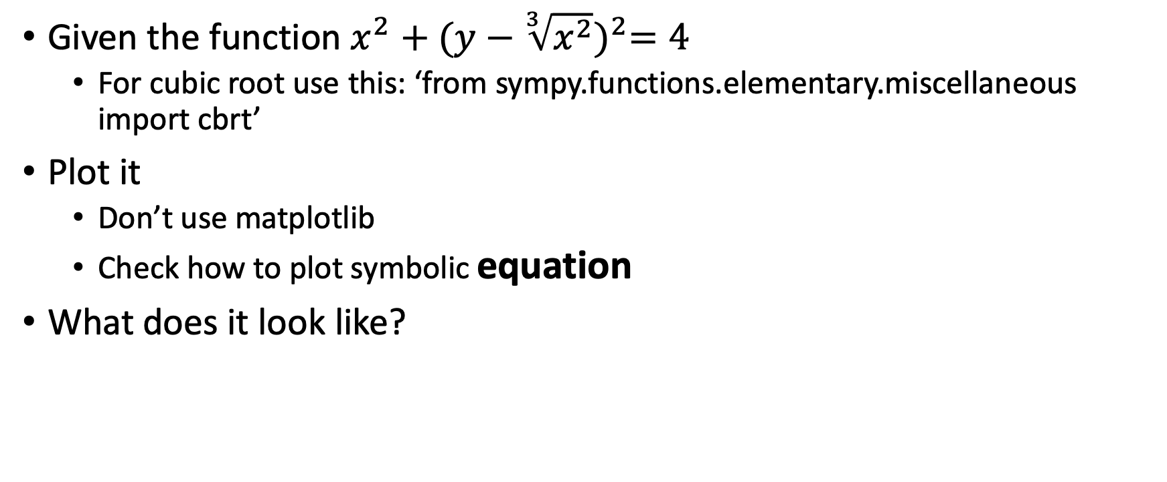
plot (10 points)
Given the function $x^{2}+{(y−\sqrt[3]{x^{2}})}^{2}=4$
For cubic root use this: ‘from sympy.functions.elementary.miscellaneous import cbrt’
Plot it
Don’t use matplotlib
Check how to plot symbolic equation
What does it look like?

Slide 5
Direction Field (15 points for each)
Suppose the differential equation : y’ = 4y + 5t
(a) Solve the differential equation (display y(t) = ??? in the command window)
Solve it symbolically!!!
(b) Plot the direction field with x and y between -5 and 5
numpy.arange might be helpful
Use meshgrid from numpy and quiver from matplotlib
Plenty of examples on how to use them
Scaled +10 points

Slide 6
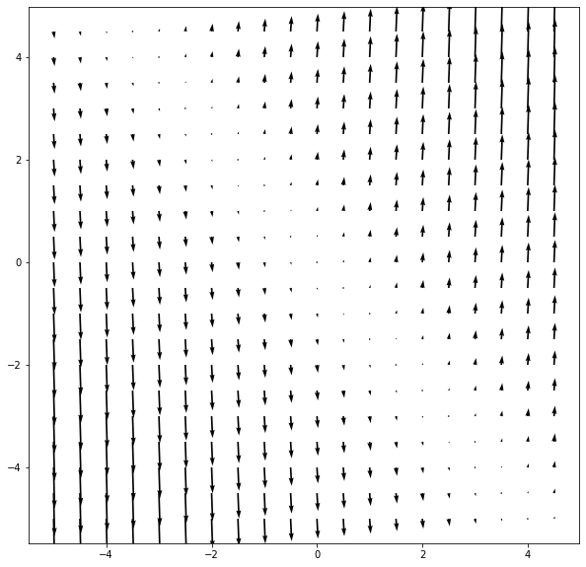
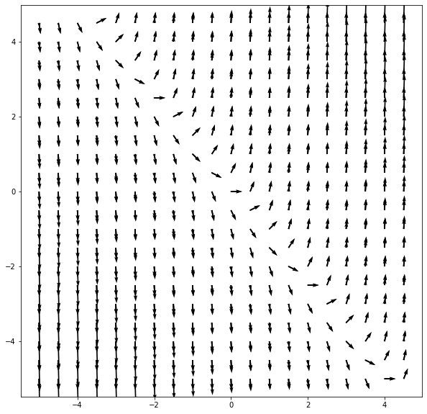
Original
Scaled

Slide 7
Good Luck! ☺

